Slide 1
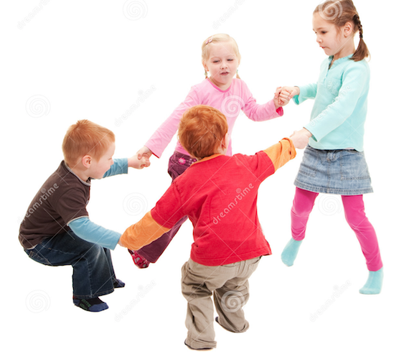
Ready, SET. Learn
Do you have a child that is 3 or 4 years old and is NOT starting kindergarten in September? Join us for 2 fun sessions.
In the library at Alwin Holland
Friday, April 21st from 10-11am
Friday, May 5th from 10-11am
RSVP- 250-785-6125

